Slide 1
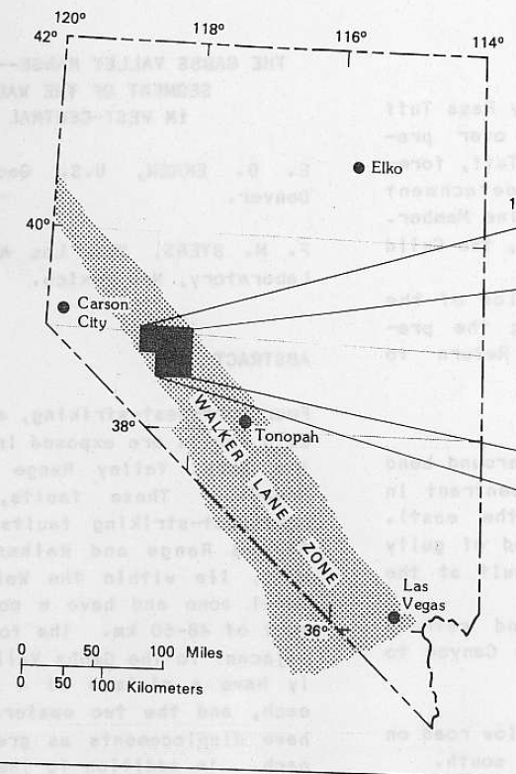
The Gabbs Valley Range-Well Exposed Segment of the Walker Lane in West-Central Nevada
Ekren and Byers, 1984
1984 Annual meeting of the Geological Society of America
Presentation by Kurt Kraal
Paper Goals: Using Geologic Maps, constrain displacement, style, and timing of faulting in this section of the walker lane

Slide 2
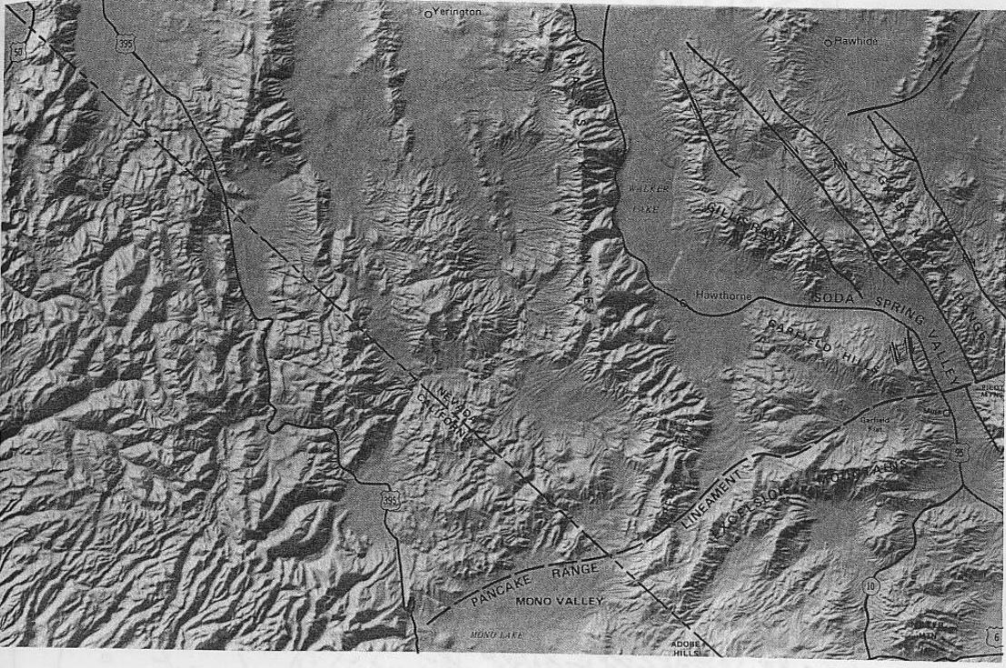
Regional Background
Study area lies north of the Pancake Range lineament
This lineament separates conspicuous Strike-Slip faults that lie in a narrow zone (North) from less easily discerned broad regional distributed shear (South)

Slide 3
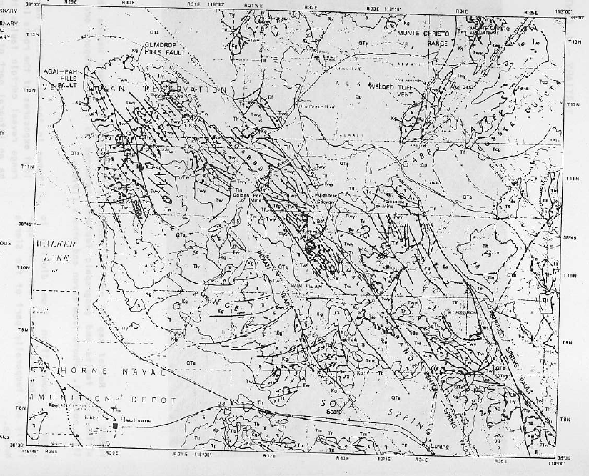
Right-Slip Faults
Part One: Right Slip Faults
Name: Indian Head Fault:
Location: Westernmost fault in Gabs Valley Range
Total Offset: Based on offset of marker bed in Luning Formation (Triassic), displacement of this fault is ~4 km
Youngest Movement: Does offset Alluvium, so Pleistocene?
Oldest Movement: before 5.8 M.Y., due to presence of landslipped debris from a 5.8 m.y. intrusion in exposers east of the fault suggest extensive displacement prior to intrusion

Slide 4
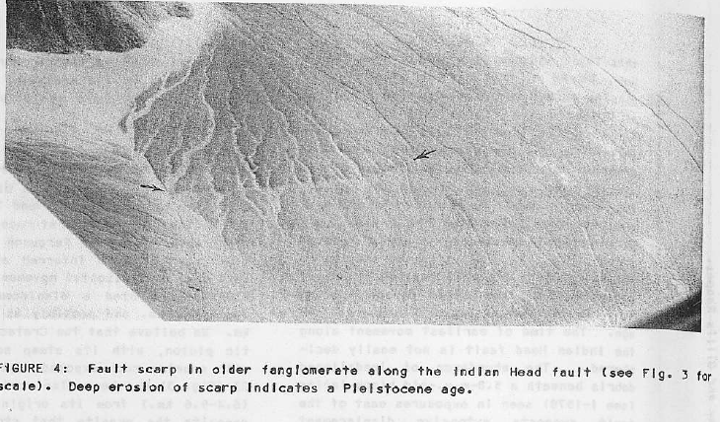
Right-Slip Faults
Part One: Right Slip Faults
Name: Indian Head Fault:
Location: Westernmost fault in Gabs Valley Range
Total Offset: Based on offset of marker bed in Luning Formation (Triassic), displacement of this fault is ~4 km
Youngest Movement: Does offset Alluvium, so Pleistocene?
Oldest Movement: before 5.8 M.Y., due to presence of landslipped debris from a 5.8 m.y. intrusion in exposers east of the fault suggest extensive displacement prior to intrusion

Slide 5
Right-Slip Faults
Part One: Right Slip Faults
Name: Gumdrop Hills Fault:
Location: Gills Range
Total Offset: 6.4 km offset of a Mesozoic Granite, but possibly up to 9 km
Youngest Movement/Oldest Movement: Most Displacement inferred to have occurred before 5.8 M.Y., due to a 5.8 m.y. intrusion that intrudes into and across the fault

Slide 6
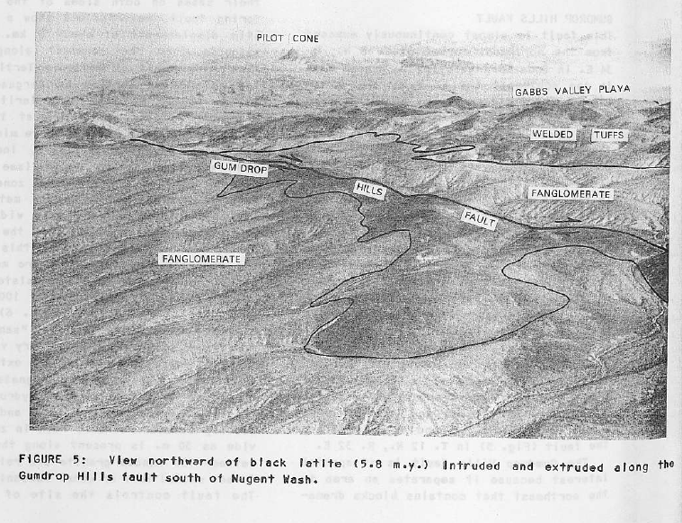
Right-Slip Faults
Part One: Right Slip Faults
Name: Gumdrop Hills Fault:
Location: Gills Range
Total Offset: 6.4 km offset of a Mesozoic Granite, but possibly up to 9 km
Youngest Movement/Oldest Movement: Most Displacement inferred to have occurred before 5.8 M.Y., due to a 5.8 m.y. intrusion that intrudes and extrudes along the fault

Slide 7
Right-Slip Faults
Part One: Right Slip Faults
Name: Benton Springs Fault
Location: in Gabbs Valley Range, near Benton Spring
Total Offset: 6.4-9.6 km based on displacement of cretaceous granitic pluton,
Timing of Movement: since there’s about ~8 km of displacement of Tertiary volcanic rocks, most movement in the Tertiary.
A Tuff deposited on preexisting fault scarp is 22-24 Ma

Slide 8
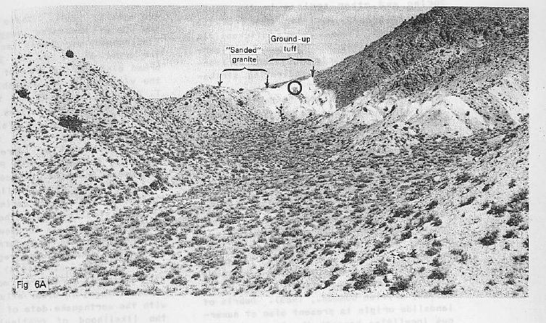
Right-Slip Faults
Part One: Right Slip Faults
Name: Benton Springs Fault
Location: in Gabbs Valley Range, near Benton Spring
Total Offset: 6.4-9.6 km based on displacement of cretaceous granitic pluton,
Timing of Movement: since theres about ~8 km of displacement of Tertiary volcanic rocks, most movement in the Tertiary

Slide 9
Right-Slip Faults
Part One: Right Slip Faults
Name: Petrified Springs Fault
Location: Eastern Gabbs Valley Range, near Petrified Spring
Total Offset: Undetermined due to lack of marker beds. (up to 16 km possibly due to copper mountain tuff displacement)
Timing of Movement: Recent movement from 1932 earthquake, older bounds unknown

Slide 10
Right-Slip Faults
Part Two: Left Slip Faults
They exist, many show small displacement
Seem to form a single system with right slip faults as conjugate wrench faults

Slide 11
Right-Slip Faults
Part Three: Normal Faults
Listric Normal Fault Example: from Wildhorse Canyon

Slide 12
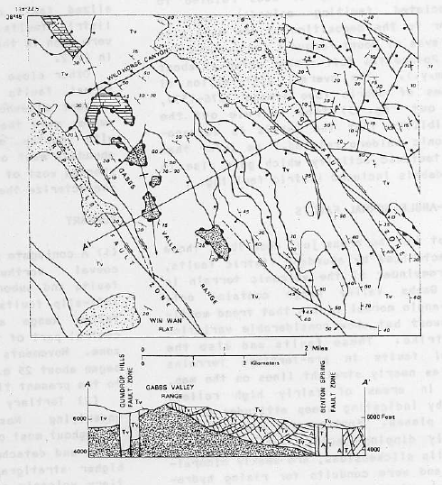
Right-Slip Faults
Part Three: Listric Faults
Example: from Wildhorse Canyon

Slide 13
Summary
This study presents maps of the Gabbs Valley Range and region showing:
4 northwest-striking right lateral strike-slip faults
Based on geologic mapping, these 4 faults have at least 4 km of displacement each (up to 10-16 km for 2 of the faults)
Also a few conjugate left-slip faults in the region, one which has at least 10-15 km of left-slip displacement
Listric normal faults also occur
Strike-slip faulting commenced about 25-m.y. and continues into recent time

